Slide 1
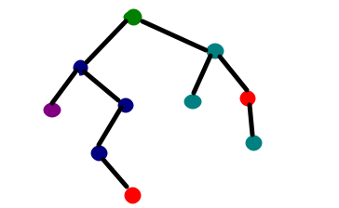
DECISION TREE
What it is?
python implementation
Use cases

Slide 2
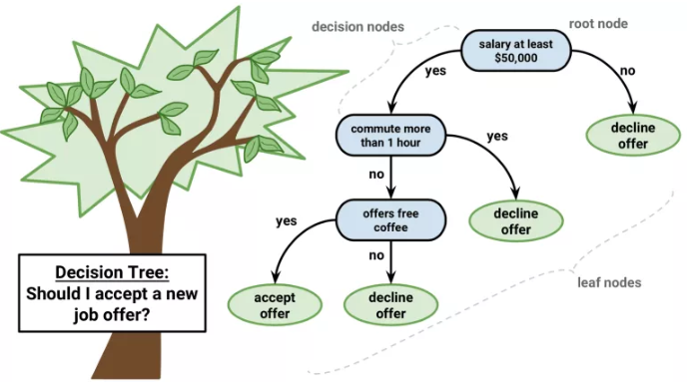
WHAT IT IS
Decision tree is a natural process of conscious and subconscious interpretation of rules and taking actions.
Data Science, does the same !!
Is this real
that such simple algorithm can solve
complicated classification problem?
The answer is: Yes!

Slide 3
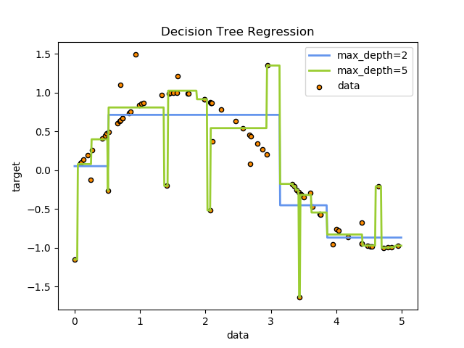
DECISION TREES
Decision Trees (DTs) are a non-parametric supervised learning method used for classification and regression.
The goal is to create a model that predicts the value of a target variable by learning simple decision rules inferred from the data features.
For instance, in the example below, decision trees learn from data to approximate a sine curve with a set of if-then-else decision rules.
The deeper the tree, the more complex the decision rules and the fitter the model.

Slide 4
TYPES OF DECISION TREES
Categorical Variable Decision Tree | Continuous Variable Decision Tree
A decision tree which has a categorical target variable | A decision tree which has continuous target variable
Example:- Let’s say we have a problem to predict whether a bike is good or not. This can be judged by using a decision tree classifier. | However, to qualify the bike into the good or bad category, mileage becomes an important factor. Mileage is measured using a contiguous value hence it can be measured using the decision tree regressor.

Slide 5
TERMS
Terms | Description
Root Node | It represents the entire population or sample, and this further gets divided into two or more homogeneous sets.
Splitting | It is a process of dividing a node into two or more sub-nodes.
Decision Node | When a sub-node splits into further sub-nodes, then it is called a decision node.
Leaf/ Terminal Node | Nodes that do not split are called Leaf or Terminal nodes.
Pruning | When we remove sub-nodes of a decision node, this process is called pruning. You can say the opposite process of splitting.
Branch / Sub-Tree: | A sub-section of entire tree is called a branch or sub-tree.
Parent and Child Node: | A node, which is divided into sub-nodes is called the parent node of sub-nodes whereas sub-nodes are the children of a parent node.

Slide 6
DECISION CRITERIA
So how do we decide on which feature/column/dimension to start with?
It is not done randomly !!! It is based on some considerations
Each time a subset is created out of parent set, the considerations are repeated
Why? Because the decision tree algorithm is a greedy one!
Algorithms behind the decision tree
ID3 - uses Entropy function and Information gain as metrics..
C4.5 or C5.0
CART - uses Gini Index(Classification) as metric.
CHAID
MARs

Slide 7
TREE ALGORITHMS: ID3, C4.5, C5.0 AND CART
ID3 (Iterative Dichotomiser 3 | C4.5 | C5.0 | CART (Classification and Regression Trees)
Developed in 1986 by Ross Quinlan. The algorithm creates a multiway tree, finding for each node the categorical feature that will yield the largest information gain for categorical targets. Trees are grown to their maximum size and then a pruning step is usually applied to improve the ability of the tree to generalize the unseen data. | is the successor to ID3 removed the restriction that features must be categorical converts the trained trees (i.e. the output of the ID3 algorithm) into sets of if-then rules | Quinlan’s latest version release under a proprietary license. It uses less memory and builds smaller rulesets than C4.5 while being more accurate. | is very similar to C4.5, but it differs in that it supports numerical target variables (regression) does not compute rule sets. CART constructs binary trees using the feature and threshold that yield the largest information gain at each node. scikit-learn uses an optimized version of the CART algorithm.

Slide 8
ENTROPY (IMPURITY)
According to Wikipedia, … Entropy refers to disorder or uncertainty.
Definition: Entropy is the measures of impurity, disorder or uncertainty in a bunch of examples.
Entropy = − ∑p_{j} log₂p_{j}
There are 3 commonly used impurity measures used in binary decision trees:
- Entropy,
- Gini index,
- and Classification Error.

Slide 9
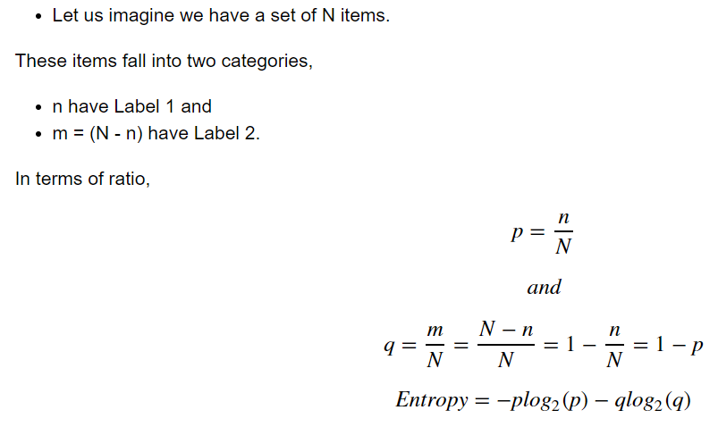
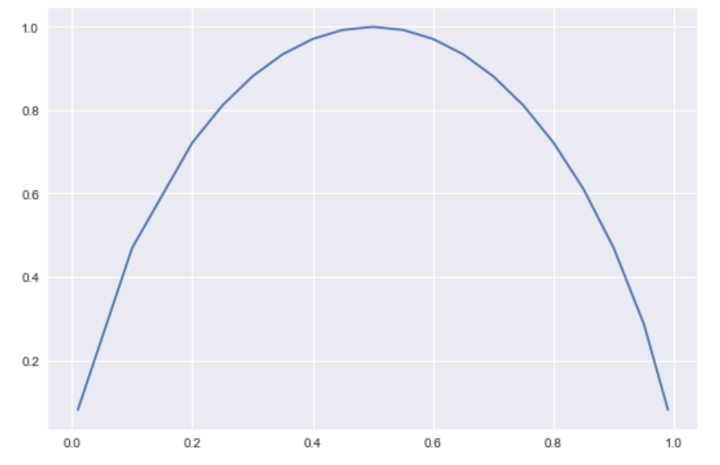
MATHEMATICAL INTUITION OF ENTROPY
Refer entropy.xlsx
minimal value at equal class distribution
minimal value if only
1 class left in S
A set is tidy if it contains only items with the same label and messy if it is a mix of items with different labels.
With no item with label 1 (p=0) or if the set is full of items with Label 1 (p=1), the entropy is zero. LEAST MESSY
With half in Label 1, half in Label 2 (p=1/2), the entropy is maximal (equals to 1) .. MOST MESSY, symmetric , among the two categories to classify, there not one which is messier than the other.

Slide 10
MEANING
Entropy = 0, This is not a good set for training.
Entropy = 1, This is a good set for training.
The entropy is an absolute measure which provides a number between 0 and 1,

Slide 11
EVOLUTION OF ENTROPY
In decision trees, at each branching, the input set is split in 2.
Compare entropy before and after the split.
E.g. start with a messy set with entropy one (half/half, p=q).
In the worst case, it could be split into 2 messy sets where half of the items are labeled 1 and the other half have Label 2 in each set. Hence the entropy of each of the two resulting sets is 1. In this scenario, the messiness has not changed
We can not sum the entropies of the two sets.
A solution, often used in mathematics, is to compute the mean entropy of the two sets. In this case, the mean is one.
However, in decision trees, a weighted sum of entropies is computed instead (weighted by the size of the two subsets)

Slide 12

IT MEANS …
N₁ and N₂ are the number of items of each sets after the split and E₁ and E₂ are their respective entropy.
It gives more importance to the set which is larger

Slide 13
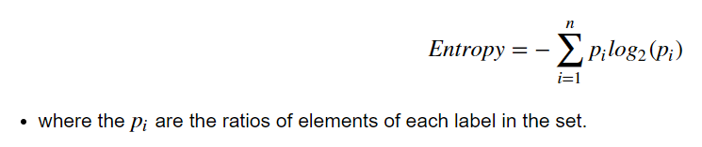
GENERALIZATION
If you have more than 2 labels, you can generalize the Entropy formula as follows:

Slide 14
INFORMATION GAIN
Definition: Information gain (IG) measures how much “information” a feature gives us about the class.
Why it matters ?
Decision Trees algorithm will always try to maximize Information gain.
An attribute with highest Information gain will be tested/split first.
Information gain = entropy(parent) – [weighted average] * entropy(children)

Slide 15

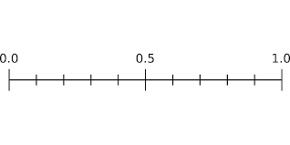
EXAMPLE – USING IMPURITY (ENTROPY)
STEP – 1 - Calculate entropy of the target.
current dataset S.
compute the Entropy H(S) on S as follows:
where K is the number of classes,
p(y_{j}) is the proportion of number of
elements of p(y_{j}) class to the number of entire elements in output of S
H(S) tell us how uncertain our dataset is.
It ranges from 0 to 1, which 0 is the case when the output contains only one class (pure), whereas 1 is the most uncertain case.
H(S) 0 – pure set
H(S) 1 – most uncertain
when the proportion of each class is equal to others’
if the number of YES is equal to the number of NO on the considered subset, then it’s easy to see that there is a big chance that it can’t be fully classified (that’s why we call it the most uncertain case).

Slide 16

EXAMPLE – USING IMPURITY (ENTROPY)
STEP – 2 The dataset is then split on the different attributes. The entropy for each branch is calculated. Then it is added proportionally, to get total entropy for the split. The resulting entropy is subtracted from the entropy before the split. The result is the Information Gain, or decrease in entropy.
Information Gain is computed separately on each feature of the current dataset S,
The value indicates how much the uncertainty in S was reduced after splitting S using feature A.
Lastly, split the current dataset S using the feature which has the highest Information Gain.

Slide 17
EXAMPLE – USING IMPURITY (ENTROPY)
STEP – 3 Choose attribute with the largest information gain as the decision node, divide the dataset by its branches and repeat the same process on every branch.

Slide 18
DATASET
features
Target/label/prediction
Weather | Temperature | Humidity | Injure | Mood | RUN
clear | <10 | <70 | slightly | happy | NO
shower | 20~30 | >80 | fit | stressed | YES
storm | 10~20 | >80 | fit | happy | NO
shower | 10~20 | >80 | slightly | stressed | YES
clear | >30 | 70~80 | fit | lazy | YES
storm | 20~30 | >80 | fit | stressed | NO
clear | >30 | 70~80 | severe | happy | NO
clear | 10~20 | <70 | severe | stressed | NO
shower | 10~20 | 70~80 | slightly | happy | NO
shower | >30 | >80 | fit | happy | YES
storm | 20~30 | 70~80 | slightly | happy | NO
clear | 10~20 | <70 | slightly | happy | ?
Training data
Test data

Slide 19
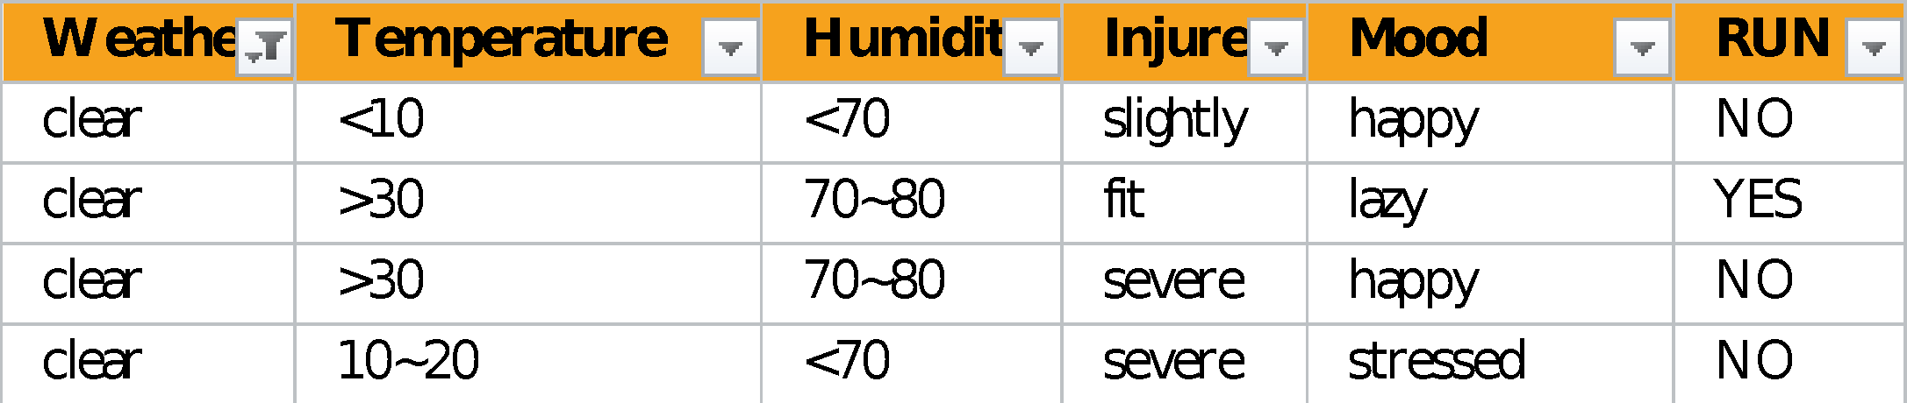
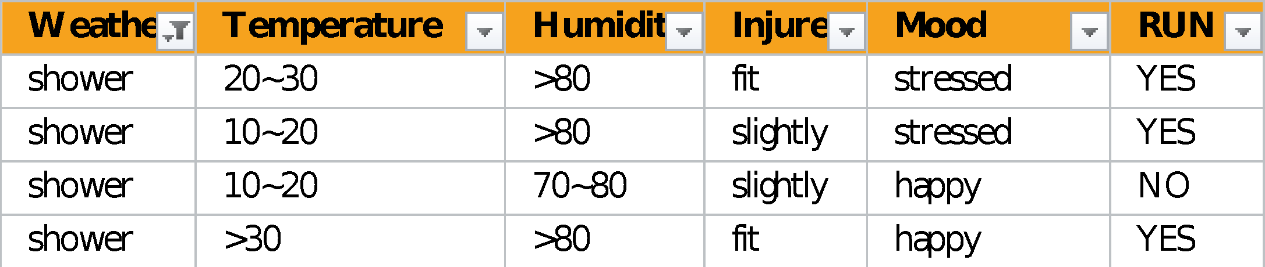
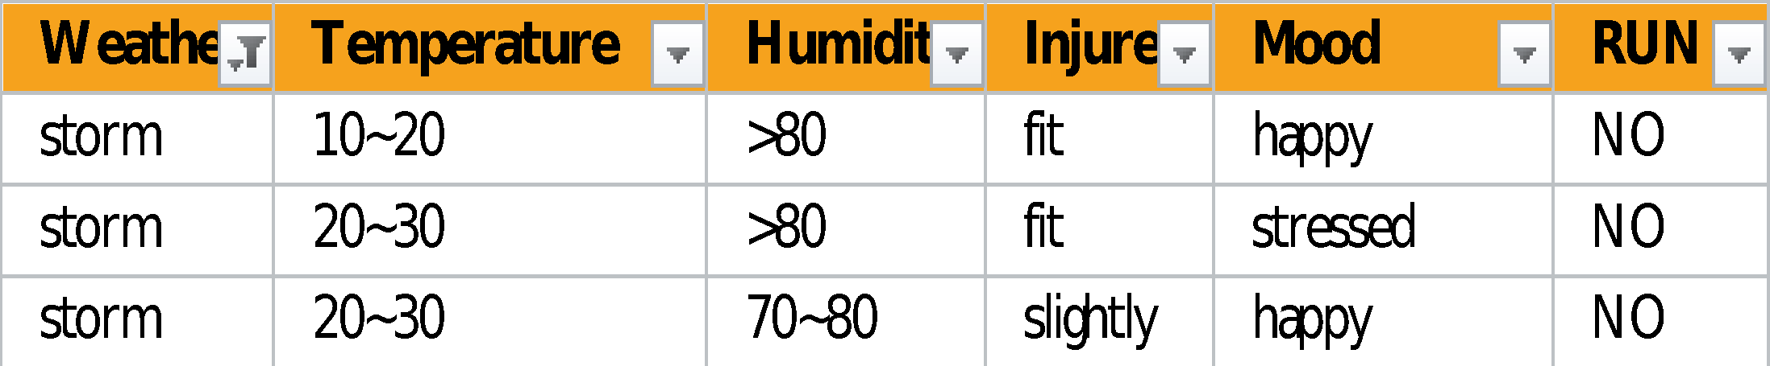
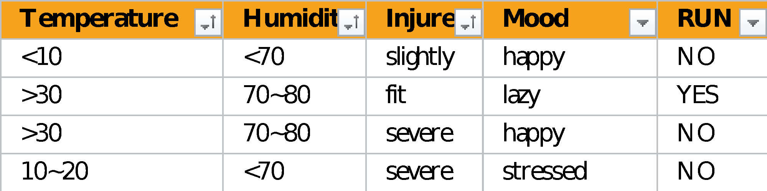
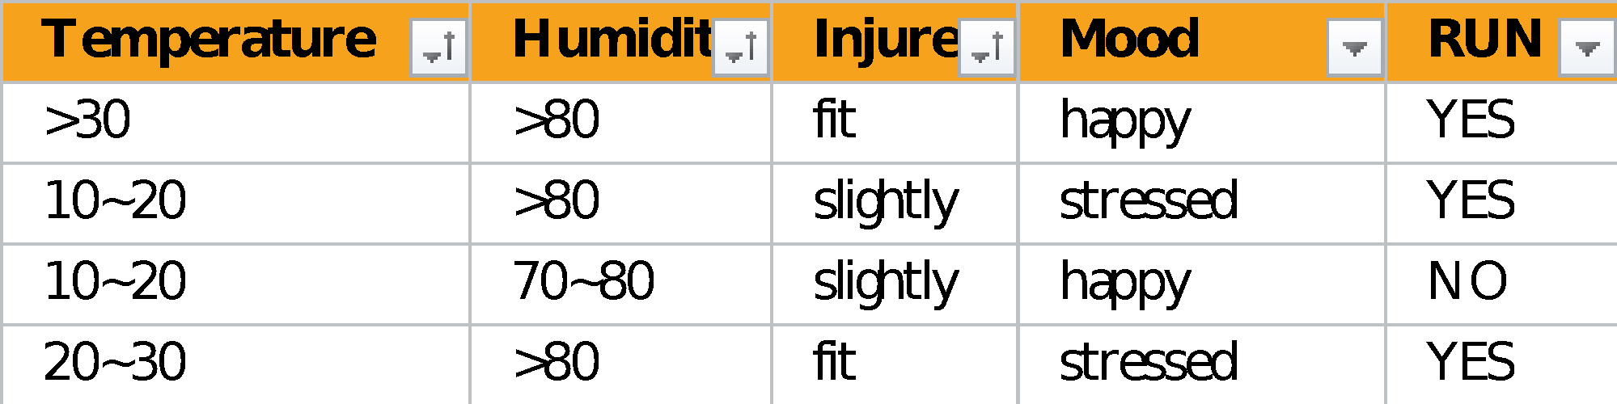
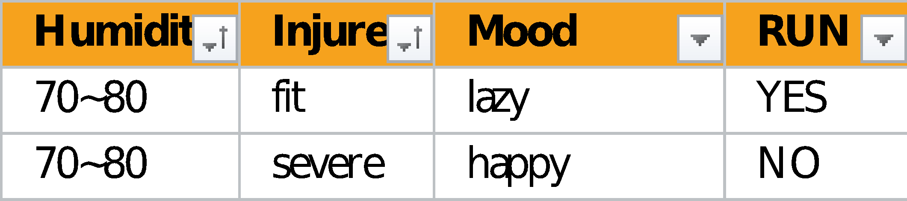
HOW THE ALGORITHM WORKS
weather
clear
shower
storm
Continues …

Slide 20
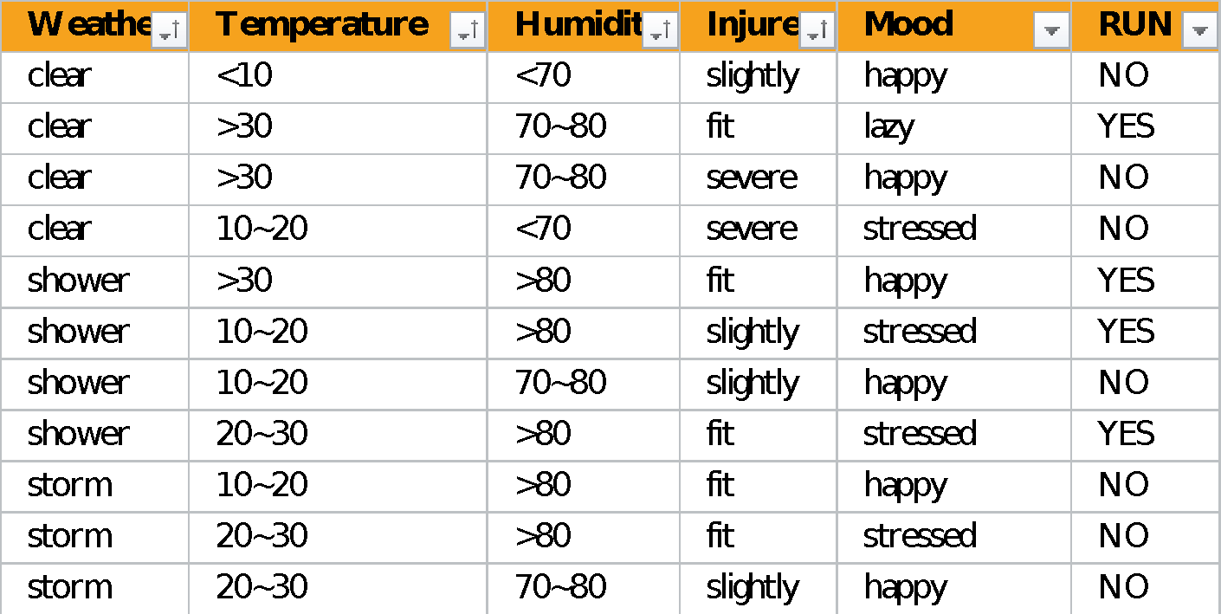
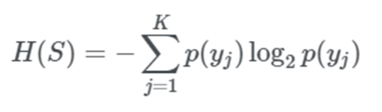
EXAMPLE – HOW DID IT WORK ON PREVIOUS DATASET
H(S) would be the entire original table
Entropy H(S) =
= -p(YES) log₂p(YES) – p(NO) log₂p(NO)
= -(4/11) log₂(4/11) – (7/11) log₂(7/11)
= 0.9457

Slide 21
EXAMPLE – HOW DID IT WORK ON PREVIOUS DATASET
Next, we will compute Information Gain on each feature. For weather feature
3 possible values: clear, shower and storm.
clear - p(clear) = 4/11
YES 1
NO 3
Entropy H(clear)
= -p(YES) log2p(YES) – p(NO) log2p(NO)
= -(1/4) log₂(1/4) – (3/4) log₂(3/4)
= 0.8113
shower - p(shower) = 4/11
YES 3
NO 1
Entropy H(Shower)
= -p(YES) log2p(YES) – p(NO) log2p(NO)
= -(3/4) log₂(3/4) – (1/4) log₂(1/4)
= 0.8113
storm - p(storm) = 3/11
YES 0
NO 3
Entropy H(storm)
= -p(YES) log2p(YES) – p(NO) log2p(NO)
= -(0/3) log₂(0/3) – (3/3) log₂(3/3)
= 0

Slide 22

EXAMPLE – HOW DID IT WORK ON PREVIOUS DATASET
So now we can compute the Information Gain on the Weather feature as follow
Continue repeat this process with other features, you will likely end up with results like this:
IG (Weather, S) = 0.3557
IG (Temperature, S) = 0.1498
IG (Humidity, S) = 0.2093
IG (Injure, S) = 0.2093
IG (Mood, S) = 0.2275
From the results above, IG on Weather has the highest value, so use Weather as a splitting condition will have the highest chance to reduce the uncertainty of dataset S, and may lead to a good classification in the end.

Slide 23
EXAMPLE - ENTROPY OF TARGET
8 records with negative class and 8 records with positive class. So, we can directly estimate the entropy of target as 1.
IG for the entire data set
E(8, 8) = -1 * [ ( p(+ve) * log( p(+ve) ) ) + ( p(-ve) * log( p(-ve) ) ) ]
= -1 * [ ( 8/16) * log₂(8/16 ) ) ) + ( (8/16) * log₂(8/16) ) ) ]
= 1
Variable label |  |  |  | A | B | C | D
pos | neg |  |  | >= 5 | >= 3.0 | >= 4.2 | >= 1.4
8 | 8 |  |  | < 5 | < 3.0 | < 4.2 | < 1.4

Slide 24
ENTROPY OF TARGET
For the variable A,
var A has value >=5 for 12 records out of 16 and 4 records with value <5 value.
For Var A >= 5 & class == positive: 5/12
For Var A >= 5 & class == negative: 7/12
Entropy(5, 7) = -1 * ( (5/12)*log2(5/12) + (7/12)*log2(7/12)) = 0.9799
For Var A <5 & class == positive: 3/4
For Var A <5 & class == negative: 1/4
Entropy(3, 1) = -1 * ( (3/4)*log2(3/4) + (1/4)*log2(1/4)) = 0.81128
Entropy(Target, A) = P(>=5) * E(5,7) + P(<5) * E(3,1)
= (12/16) * 0.9799 + (4/16) * 0.81128 = 0.937745
IG = E(Target) – E(Target, A)
= 1 – 0.937745 = 0.062255

Slide 25
ENTROPY OF TARGET
For the variable B,
var B has value >=3 for 12 records out of 16 and 4 records with value <5 value.
For Var B >= 3 & class == positive: 8/12
For Var B >= 3 & class == negative: 4/12
Entropy(8, 4) = -1 * ( (8/12)*log₂(8/12) + (4/12)*log₂(4/12)) = 0.39054
For Var B <5 & class == positive: 0/4
For Var B <5 & class == negative: 4/4
Entropy(0, 4) = -1 * ( (0/4)*log₂(3/4) + (4/4)*log₂(4/4)) = 0
Entropy(Target, B) = P(>=5) * E(5,7) + P(<5) * E(3,1)
= (12/16) * 0.39054 + (4/16) * 0 = 0.292905
IG = E(Target) – E(Target, B)
= 1 – 0.292905 = 0.707095

Slide 26
ENTROPY OF TARGET
For the variable C,
var C has value >= 4.2 for 6 records out of 16 and 10 records with value < 4.2 value.
For Var C >= 4.2 & class == positive: 0/6
For Var C >= 4.2 & class == negative: 6/6
Entropy(0, 6) = -1 * ( (0/6)*log₂(0/6) + (6/6)*log₂(6/6)) = 0
For Var C <4.2 & class == positive: 8/10
For Var C <4.2 & class == negative: 2/10
Entropy(8, 2) = 0.72193
Entropy(Target, C) = P(>=4.2) * E(0, 6) + P(<4.2) * E(8, 2)
= (6/16) * 0 + (10/16) * 0.72193 = 0.4512
IG = E(Target) – E(Target, C)
= 1 – 0.4512 = 0. 5488

Slide 27
ENTROPY OF TARGET
For the variable D,
var D has value >= 1.4 for 5 records out of 16 and 11 records with value < 1.4 value.
For Var D >= 1.4 & class == positive: 0/5
For Var D >= 1.4 & class == negative: 5/5
Entropy(0, 5) = 0
For Var D < 1.4 & class == positive: 8/11
For Var D < 1.4 & class == negative: 3/11
Entropy(8, 3) = -1 * ( (8/11)*log2(8/11) + (3/11)*log2(3/11)) = 0.84532
Entropy(Target, D) = P(>= 1.4) * E(0, 5) + P(< 1.4) * E(8, 3 )
= 5/16 * 0 + (11/16) * 0.84532 = 0.5811575
IG = E(Target) – E(Target, D)
= 1 – 0.5811575 = 0. 41189

Slide 28
DECISION
build a decision tree.
place the attributes on the tree according to their values.
An Attribute with better value than other should position as root
A branch with entropy 0 should be converted to a leaf node.
A branch with entropy more than 0 needs further splitting.
 |  | Target |  |  |  |  | Target
 |  | Positive | Negative |  |  |  | Positive | Negative
A | >= 5.0 | 5 | 7 |  | B | >= 3.0 | 8 | 4
 | <5 | 3 | 1 |  |  | < 3.0 | 0 | 4
Information Gain of A = 0.062255 |  |  |  |  | Information Gain of B= 0.7070795
 |  | Target |  |  |  |  | Target
 |  | Positive | Negative |  |  |  | Positive | Negative
C | >= 4.2 | 0 | 6 |  | D | >= 1.4 | 0 | 5
 | < 4.2 | 8 | 2 |  |  | < 1.4 | 8 | 3
Information Gain of C= 0.5488 |  |  |  |  | Information Gain of D= 0.41189

Slide 29
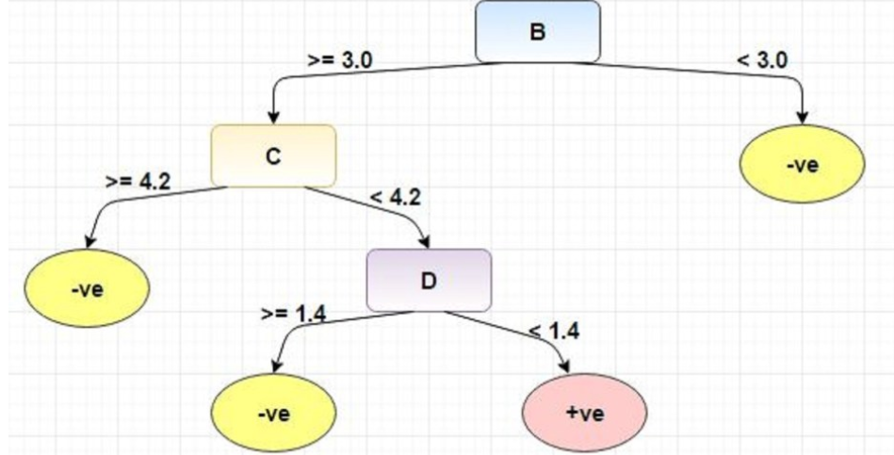
AND THE TREE …

Slide 30
SHORTCOMINGS OF THE ENTROPY MEASURE
The information gain measure is biased towards the attributes that have more number of unique values
Problem: If an attribute has a large number of values probably the resulting tree will be larger
The reason for that bias resides in the weight given to the values

Slide 31
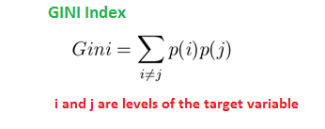
GINI INDEX
Gini Index is a metric to measure how often a randomly chosen element would be incorrectly identified.
It means an attribute with lower gini index should be preferred.

Slide 32
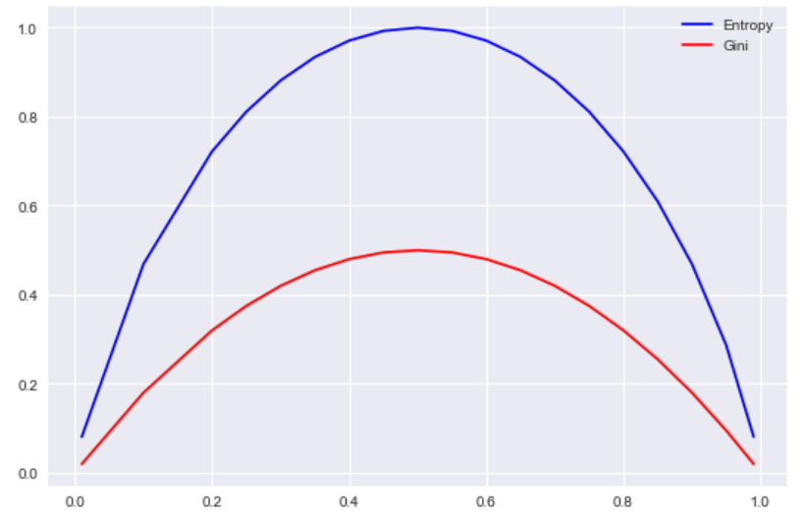
INTUITION
According to scikit-learn documentation, gini plays the same role as entropy
As we can see, there is not much differences.

Slide 33
GINI INDEX
For the variable A,
var A has value >=5 for 12 records out of 16 and 4 records with value <5 value.
For Var A >= 5 & class == positive: 5/12
For Var A >= 5 & class == negative: 7/12
gini(5, 7) = 1- ( (5/12)^2 + (7/12)^2 ) = 0.4860
For Var A <5 & class == positive: 3/4
For Var A <5 & class == negative: 1/4
gini(3,1) = 1- ( (3/4)^2 + (1/4)^2 ) = 0.375
By adding weight and sum each of the gini indices:
gini(Target, A) = (12/16) * 0.4860 + (4/16) * 0.375 = 0.45825

Slide 34
GINI INDEX
For the variable B,
var B has value >=3 for 12 records out of 16 and 4 records with value <5 value.
For Var B >= 3 & class == positive: 8/12
For Var B >= 3 & class == negative: 4/12
gini(8,4) = 1- ( (8/12)2 + (4/12)2 ) = 0.446
For Var B <5 & class == positive: 0/4
For Var B <5 & class == negative: 4/4
gin(0,4) = 1- ( (0/4)2 + (4/4)2 ) = 0
By adding weight and sum each of the gini indices:
gini(Target, B) = (12/16) * 0.446 + (4/16) * 0 = 0.3345

Slide 35
DECISION
 |  | Target |  |  |  |  | Target
 |  | Positive | Negative |  |  |  | Positive | Negative
A | >= 5.0 | 5 | 7 |  | B | >= 3.0 | 8 | 4
 | <5 | 3 | 1 |  |  | < 3.0 | 0 | 4
Gini Index of X1 = 0.45825 |  |  |  |  | Gini Index of X2= 0.3345
 |  | Target |  |  |  |  | Target
 |  | Positive | Negative |  |  |  | Positive | Negative
C | >= 4.2 | 0 | 6 |  | D | >= 1.4 | 0 | 5
 | < 4.2 | 8 | 2 |  |  | < 1.4 | 8 | 3
Gini Index of X3= 0.2 |  |  |  |  | Gini Index of X4= 0.273
Notes:
Lowest gini index as root and for entropy highest entropy as root

Slide 36
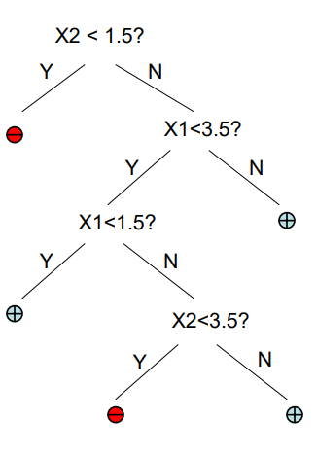
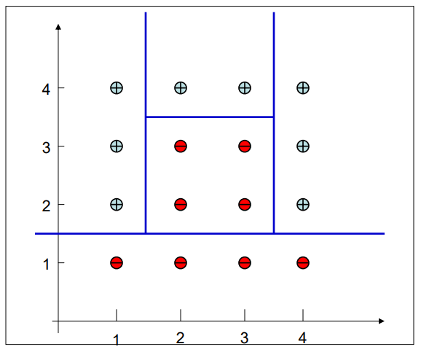
DECISION BOUNDARIES
X2
Decision Trees divide the input space into axis-parallel rectangles
and label each rectangle with one of the K classes
X1

Slide 37
ENTROPY VS GINI
Gini is intended for continuous attributes,
Entropy for attributes that occur in classes
Entropy may be a little slower to compute

Slide 38
DECISION TREE VARIATIONS
Input/ predictor variables | Target/ output variable | ML type | Decision criteria
Discreet | Discreet | Classification | (entropy, gini)
Discreet | Continuous | Regression | (entropy, gini)
Continuous | Continuous | Regression | (threshold split)
Continuous | Discreet | Classification | (threshold split)
Continuous/ Discreet | Discreet | Classification | Mix
Continuous/ Discreet | Continuous | Regression | Mix

Slide 39
NUMERIC VARIABLES - ENTROPY-BASED DISCRETIZATION
data relating the number of hours various students studied in an attempt to determine its effect on their test performance
Sort the feature (hours studied)
HOURS STUDIED | GRADE A ON TEST
4 | N
5 | Y
8 | N
12 | Y
15 | Y

Slide 40
NUMERIC VARIABLES - ENTROPY-BASED DISCRETIZATION
Step 1: start by calculating entropy of the data set itself
E(D) = - (3/5 log₂(3/5) + 2/5 log₂(2/5)) = .529 + .442 = .971
 | A ON TEST | LOWER THAN A
Overall | 3 | 2

Slide 41
NUMERIC VARIABLES - ENTROPY-BASED DISCRETIZATION
Step 2: let's iterate through and see which splits give us the maximum entropy gain. To find a split, we average two neighboring values in the list.
Now we get 2 bins, as follows:
HOURS STUDIED | GRADE A ON TEST | SPLIT POINT # | SPLIT VALUE
4 | N | 1 | (4+ 5)/2 = 4.5
5 | Y
8 | N
12 | Y
15 | Y
 | A ON TEST | LOWER THAN A
<=4.5 | 0 | 1
>4.5 | 3 | 1
calculate entropy for each bin and find the information gain of this split:
E(D <= 4.5) = - (1/1 log₂(1/1) + 0/0 log₂(0/0)) = 0 + 0 = 0
E(D > 4.5) = - (1/4 log₂(1/4) + 3/4 log₂(3/4)) = .311 + .5 = .811

Slide 42
NUMERIC VARIABLES - ENTROPY-BASED DISCRETIZATION
Step 2: let's iterate through and see which splits give us the maximum entropy gain. To find a split, we average two neighboring values in the list.
Now we get 2 bins, as follows:
HOURS STUDIED | GRADE A ON TEST | SPLIT POINT # | SPLIT VALUE
4 | N | 1 | (4+ 5)/2 = 4.5
5 | Y
8 | N
12 | Y
15 | Y
 | A ON TEST | LOWER THAN A
<=4.5 | 0 | 1
>4.5 | 3 | 1
calculate entropy for each bin and find the information gain of this split:
E(D <= 4.5) = - (1/1 log₂(1/1) + 0/0 log₂(0/0)) = 0 + 0 = 0
E(D > 4.5) = - (1/4 log₂(1/4) + 3/4 log₂(3/4)) = .311 + .5 = .811
E_{net} = 1/5 (0) + 4/5 (.811) = .6488
Gain = .971 - .6488 = .322

Slide 43
NUMERIC VARIABLES - ENTROPY-BASED DISCRETIZATION
Step 2: let's iterate through and see which splits give us the maximum entropy gain. To find a split, we average two neighboring values in the list.
Now we get 2 bins, as follows:
HOURS STUDIED | GRADE A ON TEST | SPLIT POINT # | SPLIT VALUE
4 | N
5 | Y | 2 | (5 + 8)/2 = 6.5
8 | N
12 | Y
15 | Y
 | A ON TEST | LOWER THAN A
<=6.5 | 1 | 1
>6.5 | 2 | 1
calculate entropy for each bin and find the information gain of this split:
E(D <= 6.5) = - (1/2 log₂(1/2) + 1/2 log₂(1/2)) = 1
E(D > 6.5) = - (2/2 log₂(2/2) + 1/3 log₂(1/3)) = .389 + .528 = .917
E_{net} = 2/5 (1) + 3/5 (.917) = .950
Gain = .971 - .950 = .021

Slide 44
NUMERIC VARIABLES - ENTROPY-BASED DISCRETIZATION
Step 2: let's iterate through and see which splits give us the maximum entropy gain. To find a split, we average two neighboring values in the list.
Now we get 2 bins, as follows:
HOURS STUDIED | GRADE A ON TEST | SPLIT POINT # | SPLIT VALUE
4 | N
5 | Y
8 | N | 3 | (8+12)/2 = 10
12 | Y
15 | Y
 | A ON TEST | LOWER THAN A
<=10 | 1 | 2
>10 | 2 | 0
calculate entropy for each bin and find the information gain of this split:
E(D <= 10) = - (1/3 log₂(1/3) + 2/3 log₂(2/3)) = .917
E(D > 10) = - (2/2 log₂(2/2) + 0/0 log₂(0/0)) = 0
E_{net} = 2/5 (0) + 3/5 (.917) = ..55
Gain = .971 - .55 = .421

Slide 45
NUMERIC VARIABLES - ENTROPY-BASED DISCRETIZATION
Step 2: let's iterate through and see which splits give us the maximum entropy gain. To find a split, we average two neighboring values in the list.
Now we get 2 bins, as follows:
HOURS STUDIED | GRADE A ON TEST | SPLIT POINT # | SPLIT VALUE
4 | N
5 | Y
8 | N
12 | Y | 4 | (12 + 15)/2 = 13.5
15 | Y
 | A ON TEST | LOWER THAN A
<=13.5 | 2 | 2
>13.5 | 1 | 0
calculate entropy for each bin and find the information gain of this split:
E(D <= 13.5) = - (2/2 log₂(2/2) + 2/2 log₂(2/2)) = 1
E(D > 13.5) = - (1/1 log₂(1/1) + 0/1 log₂(0/1)) = 0
E_{net} = 4/5 (1) = .80
Gain = .971 - .80 = .117

Slide 46
NUMERIC VARIABLES - ENTROPY-BASED DISCRETIZATION
Step 3
After calculating everything, we find that our best split is split 3, which gives us the best information gain of .421. We will partition the data there!
According to the algorithm, we now can further bin our attributes in the bins we just created. This process will continue until we satisfy a termination criteria.

Slide 47
SCIKIT LEARN PARAMETERS
class sklearn.tree.DecisionTreeClassifier(criterion=’gini’, splitter=’best’, max_depth=None, min_samples_split=2, min_samples_leaf=1, min_weight_fraction_leaf=0.0, max_features=None, random_state=None, max_leaf_nodes=None, min_impurity_decrease=0.0, min_impurity_split=None, class_weight=None, presort=False)
criterion : string, optional (default=”gini”)
The function to measure the quality of a split.
Supported criteria are
“gini” for the Gini impurity
“entropy” for the information gain.

Slide 48
SCIKIT LEARN PARAMETERS
class sklearn.tree.DecisionTreeClassifier(criterion=’gini’, splitter=’best’, max_depth=None, min_samples_split=2, min_samples_leaf=1, min_weight_fraction_leaf=0.0, max_features=None, random_state=None, max_leaf_nodes=None, min_impurity_decrease=0.0, min_impurity_split=None, class_weight=None, presort=False)
max_depth : int or None, optional (default=None)
The maximum depth of the tree.
If None, then nodes are expanded until all leaves are pure or until all leaves contain less than min_samples_split samples.

Slide 49
SCIKIT LEARN PARAMETERS
class sklearn.tree.DecisionTreeClassifier(criterion=’gini’, splitter=’best’, max_depth=None, min_samples_split=2, min_samples_leaf=1, min_weight_fraction_leaf=0.0, max_features=None, random_state=None, max_leaf_nodes=None, min_impurity_decrease=0.0, min_impurity_split=None, class_weight=None, presort=False)
min_samples_split : int, float, optional (default=2)
The minimum number of samples required to split an internal node:
If int, then consider min_samples_split as the minimum number.
If float, then min_samples_split is a fraction and ceil (min_samples_split * n_samples) are the minimum number of samples for each split.

Slide 50
SCIKIT LEARN PARAMETERS
class sklearn.tree.DecisionTreeClassifier(criterion=’gini’, splitter=’best’, max_depth=None, min_samples_split=2, min_samples_leaf=1, min_weight_fraction_leaf=0.0, max_features=None, random_state=None, max_leaf_nodes=None, min_impurity_decrease=0.0, min_impurity_split=None, class_weight=None, presort=False)
min_samples_leaf : int, float, optional (default=1)
The minimum number of samples required to be at a leaf node. A split point at any depth will only be considered if it leaves at least min_samples_leaf training samples in each of the left and right branches. This may have the effect of smoothing the model, especially in regression.
If int, then consider min_samples_leaf as the minimum number.
If float, then min_samples_leaf is a fraction and ceil(min_samples_leaf * n_samples) are the minimum number of samples for each node.

Slide 51
SCIKIT LEARN PARAMETERS
class sklearn.tree.DecisionTreeClassifier(criterion=’gini’, splitter=’best’, max_depth=None, min_samples_split=2, min_samples_leaf=1, min_weight_fraction_leaf=0.0, max_features=None, random_state=None, max_leaf_nodes=None, min_impurity_decrease=0.0, min_impurity_split=None, class_weight=None, presort=False)
max_features : int, float, string or None, optional (default=None)
The number of features to consider when looking for the best split:
If int, then consider max_features features at each split.
If float, then max_features is a fraction and int(max_features * n_features) features are considered at each split.
If “auto”, then max_features=sqrt(n_features).
If “sqrt”, then max_features=sqrt(n_features).
If “log2”, then max_features=log2(n_features).
If None, then max_features=n_features.

Slide 52
SCIKIT LEARN PARAMETERS
class sklearn.tree.DecisionTreeClassifier(criterion=’gini’, splitter=’best’, max_depth=None, min_samples_split=2, min_samples_leaf=1, min_weight_fraction_leaf=0.0, max_features=None, random_state=None, max_leaf_nodes=None, min_impurity_decrease=0.0, min_impurity_split=None, class_weight=None, presort=False)
Weights associated with classes in the form {class_label: weight}.
If not given, all classes are supposed to have weight one.
For multi-output problems, a list of dicts can be provided in the same order as the columns of y.
for multioutput (including multilabel) weights should be defined for each class of every column in its own dict. For example, for four-class multilabel classification weights should be [{0: 1, 1: 1}, {0: 1, 1: 5}, {0: 1, 1: 1}, {0: 1, 1: 1}] instead of [{1:1}, {2:5}, {3:1}, {4:1}].
The “balanced” mode uses the values of y to automatically adjust weights inversely proportional to class frequencies in the input data as n_samples / (n_classes * np.bincount(y))

Slide 53
ATTRIBUTES
classes_ : array of shape = [n_classes] or a list of such arrays, The classes labels (single output problem), or a list of arrays of class labels (multi-output problem).
feature_importances_ : array of shape = [n_features] , Return the feature importances.
max_features_ : int, The inferred value of max_features.
n_classes_ : int or list, The number of classes (for single output problems), or a list containing the number of classes for each output (for multi-output problems).
n_features_ : int, The number of features when fit is performed.
n_outputs_ : int, The number of outputs when fit is performed.

Slide 54
REGRESSION WITH DECISION TREES
Replacing INFORMATION GAIN with Standard Deviation Reduction
A decision tree is built top-down from a root node and involves partitioning the data into subsets that contain instances with similar values (homogeneous)
We use standard deviation to calculate the homogeneity of a numeric sample
If the numeric sample is completely homogeneous, it’s S.D = 0

Slide 55
STANDARD DEVIATION REDUCTION
The SD reduction is based on the decrease in the SD after a dataset is split on an attribute
Constructing a decision tree is all about finding attribute that returns the highest SD reduction
The split is done on the feature which returns max SD reduction
Dataset is divided based on the values of the selected feature
A branch set with SD > 0 needs further splitting, the process is repeated on the non-leaf branches, until all data is processed
When the number of instances is more than 1 at a leaf node, we calculate the average as the final value for the prediction

Slide 56
SCIKIT LEARN PARAMETERS
class sklearn.tree.DecisionTreeRegressor(criterion=’mse’, splitter=’best’, max_depth=None, min_samples_split=2, min_samples_leaf=1, min_weight_fraction_leaf=0.0, max_features=None, random_state=None, max_leaf_nodes=None, min_impurity_decrease=0.0, min_impurity_split=None, presort=False)
criterion : string, optional (default=”mse”)
The function to measure the quality of a split.
Supported criteria are
“mse” for the mean squared error, which is equal to variance reduction as feature selection criterion and minimizes the L2 loss using the mean of each terminal node,
“friedman_mse”, which uses mean squared error with Friedman’s improvement score for potential splits, and
“mae” for the mean absolute error, which minimizes the L1 loss using the median of each terminal node.

Slide 57
SCIKIT LEARN PARAMETERS
class sklearn.tree.DecisionTreeRegressor(criterion=’mse’, splitter=’best’, max_depth=None, min_samples_split=2, min_samples_leaf=1, min_weight_fraction_leaf=0.0, max_features=None, random_state=None, max_leaf_nodes=None, min_impurity_decrease=0.0, min_impurity_split=None, presort=False)
max_depth : int or None, optional (default=None)
min_samples_split : int, float, optional (default=2)
min_samples_leaf
min_weight_fraction_leaf : float, optional (default=0.)
max_features : int, float, string or None, optional (default=None)

Slide 58
ATTRIBUTES
feature_importances_ : array of shape = [n_features] - Return the feature importances.
max_features_ : int, - The inferred value of max_features.
n_features_ : int - The number of features when fit is performed.
n_outputs_ : int - The number of outputs when fit is performed.

Slide 59
USE CASES
Building knowledge management platforms for customer service that improve first call resolution, average handling time, and customer satisfaction rates
In finance, forecasting future outcomes and assigning probabilities to those outcomes
Binomial option pricing predictions and real option analysis
Customer’s willingness to purchase a given product in a given setting, i.e. offline and online both
Product planning; for example, Gerber Products, Inc. used decision trees to decide whether to continue planning PVC for manufacturing toys or not
General business decision-making
Loan approval

Slide 60
ADVANTAGES
Simple to understand and to interpret. Trees can be visualized.
Requires little data preparation.
Other techniques often require
data normalization,
dummy variables need to be created
blank values to be removed.
Able to handle both numerical and categorical data.
Able to handle multi-output problems.
Resistant to outliers, hence require little data preprocessing
Highly flexible hypothesis space, as the # of nodes (or depth) of tree increases, decision tree can represent increasingly complex decision boundaries

Slide 61
DISADVANTAGES
Prone to overfitting (overly-complex )
Can create biased learned trees if some classes dominate.
It is therefore recommended to balance the dataset prior to fitting with the decision tree.
Decision trees can be unstable because small variations in the data might result in a completely different tree being generated.
This problem is mitigated by using decision trees within an ensemble.

Slide 62
DECISION TREE - OVERFITTING
Overfitting is a significant practical difficulty for decision tree models and many other predictive models.
Overfitting happens when the learning algorithm continues to develop hypotheses that reduce training set error at the cost of an increased test set error.
There are several approaches to avoiding overfitting in building decision trees.
Pre-pruning that stop growing the tree earlier, before it perfectly classifies the training set.
Post-pruning that allows the tree to perfectly classify the training set, and then post prune the tree.
Practically, the second approach of post-pruning overfit trees is more successful because it is not easy to precisely estimate when to stop growing the tree.

Slide 63
TIPS ON PRACTICAL USE
Decision trees tend to overfit on data with a large number of features. Getting the right ratio of samples to number of features is important, since a tree with few samples in high dimensional space is very likely to overfit.
Consider performing dimensionality reduction (PCA, ICA, or Feature selection) beforehand to give your tree a better chance of finding features that are discriminative.
Visualize your tree as you are training by using the export function.
Use max_depth=3 as an initial tree depth to get a feel for how the tree is fitting to your data and then increase the depth.
Remember that the number of samples required to populate the tree doubles for each additional level the tree grows too. Use max_depth to control the size of the tree to prevent overfitting.

Slide 64
STEPS
The important step of tree pruning is to define a criterion be used to determine the correct final tree size using one of the following methods:
Use a distinct dataset from the training set (called validation set), to evaluate the effect of post-pruning nodes from the tree.
Build the tree by using the training set, then apply a statistical test to estimate whether pruning or expanding a particular node is likely to produce an improvement beyond the training set.
Error estimation
Significance testing (e.g., Chi-square test)
Minimum Description Length principle : Use an explicit measure of the complexity for encoding the training set and the decision tree, stopping growth of the tree when this encoding size (size(tree) + size(misclassifications(tree)) is minimized.

Slide 66
TIPS ON PRACTICAL USE
Use min_samples_split or min_samples_leaf to ensure that multiple samples inform every decision in the tree, by controlling which splits will be considered.
A very small number will usually mean the tree will overfit, whereas a large number will prevent the tree from learning the data.
Try min_samples_leaf=5 as an initial value. If the sample size varies greatly, a float number can be used as percentage in these two parameters.
While min_samples_split can create arbitrarily small leaves, min_samples_leaf guarantees that each leaf has a minimum size, avoiding low-variance, over-fit leaf nodes in regression problems.
For classification with few classes, min_samples_leaf=1 is often the best choice.

Slide 67
TIPS ON PRACTICAL USE
Balance your dataset before training to prevent the tree from being biased toward the classes that are dominant.
Class balancing can be done by sampling an equal number of samples from each class, or preferably by normalizing the sum of the sample weights (sample_weight) for each class to the same value.
Also note that weight-based pre-pruning criteria, such as min_weight_fraction_leaf, will then be less biased toward dominant classes than criteria that are not aware of the sample weights, like min_samples_leaf.
If the samples are weighted, it will be easier to optimize the tree structure using weight-based pre-pruning criterion such as min_weight_fraction_leaf, which ensure that leaf nodes contain at least a fraction of the overall sum of the sample weights.
If the input matrix X is very sparse, it is recommended to convert to sparse csc_matrix before calling fit and sparse csr_matrix before calling predict. Training time can be orders of magnitude faster for a sparse matrix input compared to a dense matrix when features have zero values in most of the samples.

